Slide 1
E-Commerce Customer Segmentation and Prediction
By: Abhishek Sharma

Slide 2
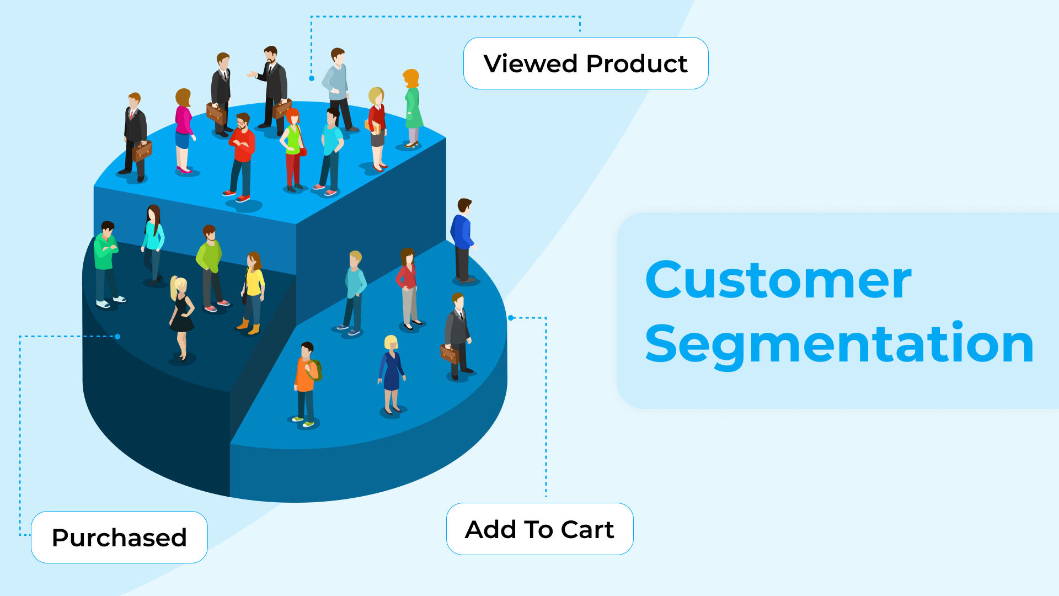
Agenda
Enhancing marketing strategies and customer retention through machine learning-based customer segmentation and prediction. By leveraging machine learning, the project seeks to segment customers and predict future purchasing behavior.

Slide 3

Project Objective
Objective: Develop a robust customer segmentation model and predictive classifier to categorize customers based on their purchasing patterns
Goal: Tailor marketing strategies, improve customer retention, and optimize inventory management.

Slide 4

Project Benefits
Enhanced Customer Segmentation: Identify and categorize customers based on purchasing behavior, allowing for targeted marketing strategies.
Cost Efficiency: Focus marketing efforts on high-value customer segments, optimizing resource allocation.
Improved Customer Satisfaction: Tailor offers and communication to specific customer needs, enhancing overall satisfaction.

Slide 5
FEATURE ENGINEERING
Extracting year Date and Month from Invoice Date
Added Feature 'Total Amount' by multiplying values from the Quantity and Unit Price column.(Sterling)
Added feature 'Time Type' based on hours to define whether its Morning, Afternoon, or Evening
Dropping Invoice No starting with 'C’ that represents cancellation

Slide 6
IMPORTING AND INSPECTING DATASET
Data set Name:- Data.csv
No of Observation:541908 (shape=8x541908)
Data Cleaning:
Customer ID - 135080(25% Missing Values)
Description - 1454 (0.27% Missing Values)
* No use of this data, it can be dropped
Checking Missing Data: Checking duplicates 5268 data points were duplicated Dropped duplicates
No of Observation left: 401604 (shape=8x 401604)

Slide 7
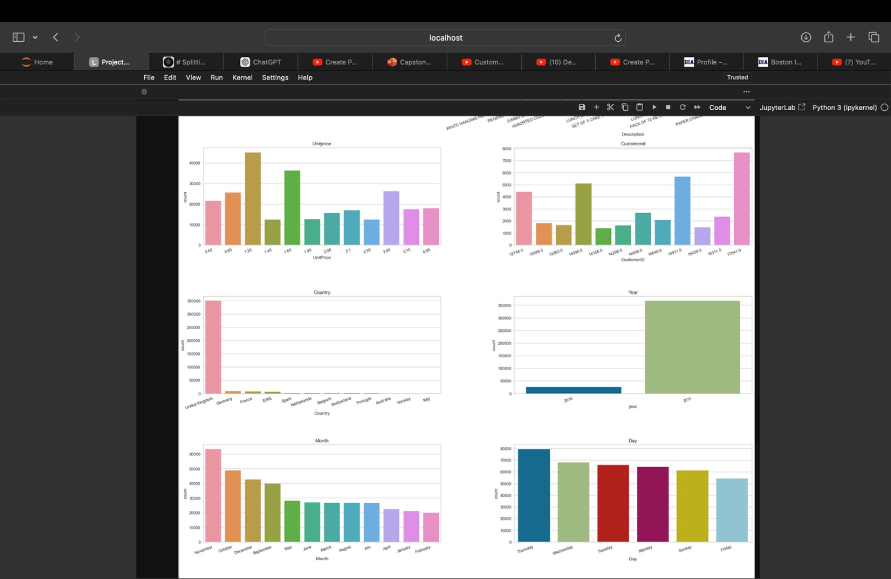
Deliverables
Exploratory Data Analysis (EDA)
Data Cleaning: Removed missing values, handled outliers, and transformed variables as necessary
Data Visualization: Created plots to understand distribution of variables, correlations, and relationships between features
Insights: Discovered key trends and patterns in customer behavior and purchasing patterns

Slide 8
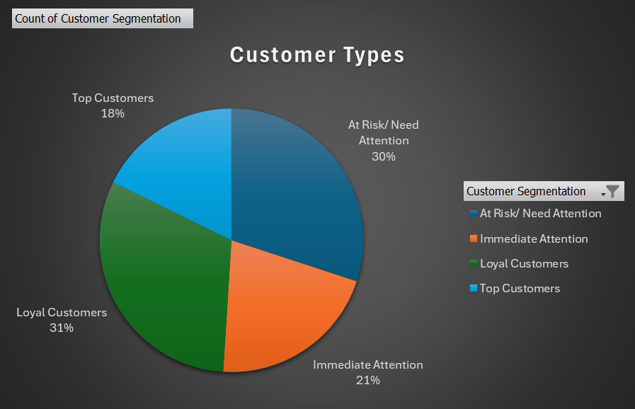
Deliverables
Analysis
Recency: Calculated time since last purchase for each customer
Monetary Value: Calculated total amount spent by each customer
Frequency: Calculated number of purchases made by each customer
Other Features: Engineered additional features relevant to customer segmentation (e.g. purchase categories, average order value)
Based on these factors we analyzed different customer
types.

Slide 9
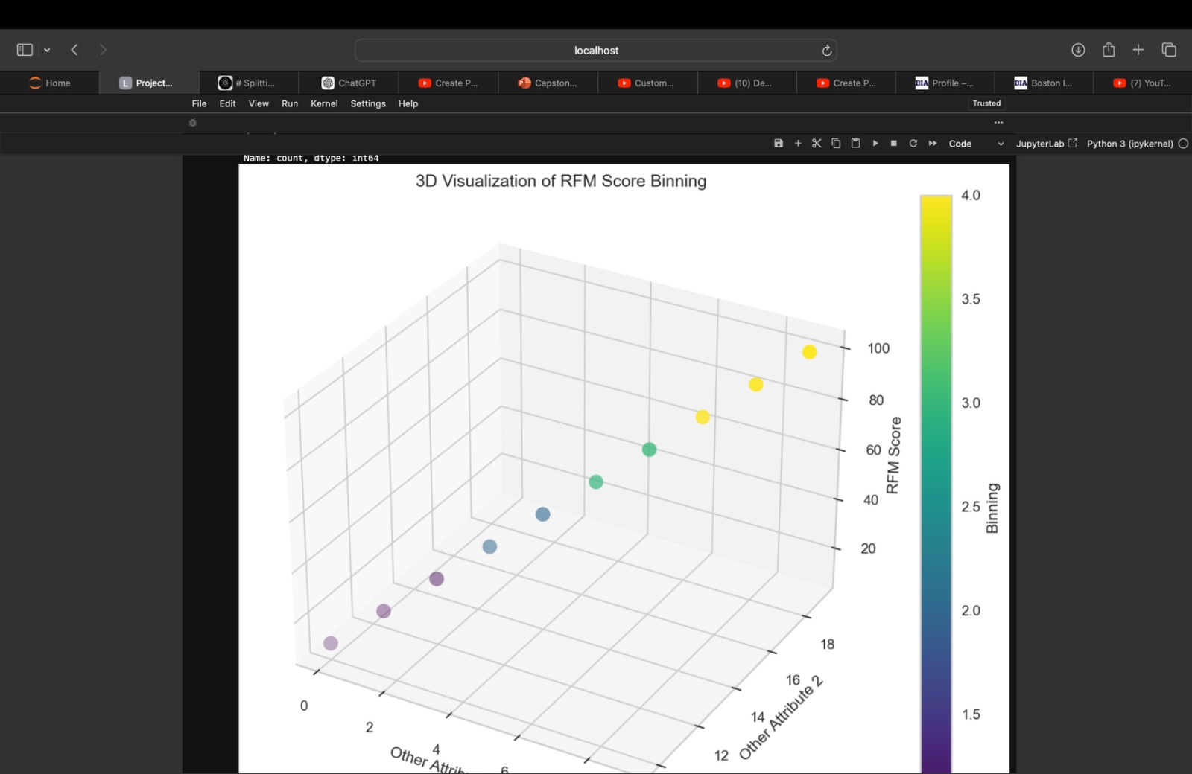
Deliverables
Clustering
Methodology: Evaluated and selected the most effective clustering algorithm (e.g. K-means, hierarchical clustering, DBSCAN)
Model Tuning: Optimized hyperparameters to improve clustering performance
Results: Identified distinct customer segments based on purchasing patterns and behavior

Slide 10
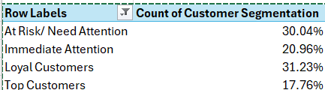
Model Evaluation
Metrics: Calculated metrics to evaluate clustering performance (e.g. silhouette score, calinski-harabasz index)
Insights: Gained insights into the characteristics of each customer segment and their purchasing behavior

Slide 11
Conclusion
Machine Learning-Based Approach: Developed a machine learning-based approach to segment e-commerce customers and predict their purchasing behavior.
Key Insights: Identified distinct customer segments and gained insights into their characteristics and purchasing patterns through EDA, feature engineering, clustering, and model evaluation.
Business Impact: Our approach has the potential to inform marketing strategies, improve customer retention, and drive business growth, enabling e-commerce companies to stay competitive and achieve maximum ROI.

Slide 12
Thank You!

